Slide 1


Computer Organization & Architecture
Chapter 13
Reduced Instruction Set Computers

Slide 2
Major Advances in Computers
The family concept
  IBM System/360 (1964), and then DEC PDP-8
  Same architecture but different implementations
Microporgrammed control unit
  Idea by Wilkes 1951
  Produced by IBM S/360 1964
Cache memory
  IBM S/360 model 85 1969
Microprocessors
  Intel 4004 1971
Pipelining
  Introduces parallelism into fetch execute cycle
Multiple processors

Slide 3
The Next Step - RISC
What is RISC
  Reduced Instruction Set Computer
  Key features
    Limited and simple instruction set with a fixed format
    Large number of general purpose registers or use of compiler technology to optimize register use
    Emphasis on optimizing the instruction pipeline

Slide 4
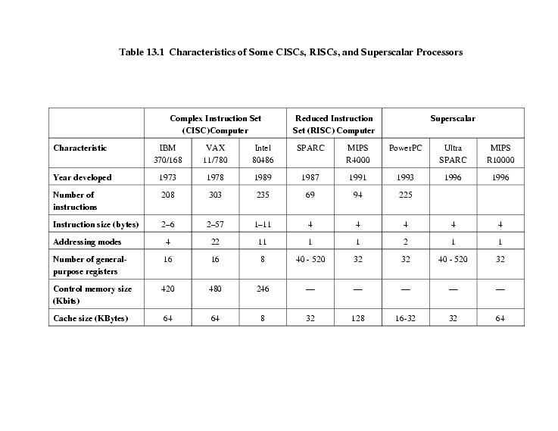
Comparison of processors

Slide 5
13.1 Instruction execution characteristics
Driving force for CISC
  Software costs far exceed hardware costs
  Increasingly complex high level languages (HLL)
  Semantic gap
Leads to
  Large instruction sets
  More addressing modes
  Hardware implementations of HLL statements
Intention of CISC
  Ease compiler writing
  Improve execution efficiency
    Complex operations in microcode
  Support more complex HLLs

Slide 6
Execution Characteristics
  Operations performed
  Operands used
  Execution sequencing
Studies have been done based on programs written in HLLs
Dynamic studies are measured during the execution of the program

Slide 7
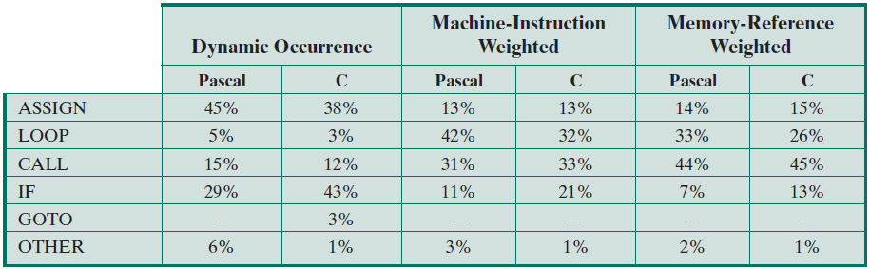
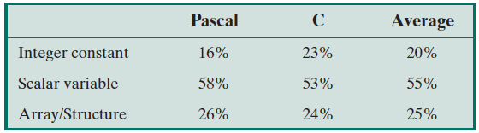

Slide 8
Operations
  Assignments
    Movement of data
  Conditional statements (IF, LOOP)
    Sequence control
  Procedure call-return is very time consuming
  Some HLL instruction lead to many machine code operations
Operands
  Mainly local scalar variables
  Optimisation should concentrate on accessing local variables

Slide 9
Procedure Calls
  Very time consuming
    Depends on number of parameters passed
    Depends on level of nesting
  The number of words used by per procedure call is not large
  Most variables are local
  Most programs do not do a lot of calls followed by lots of returns
  (c.f. locality of reference)

Slide 10
Implications
  Best support is given by optimising most used and most time consuming features
  Large number of registers
    Operand referencing
  Careful design of pipelines
    Branch prediction etc.
  Simplified (reduced) instruction set

Slide 11
13.2 The use of a large register file
Register Features:
  Faster than cache, memory
  Shorter address
  Near CPU
Software solution
  Require compiler to allocate registers
  Allocate based on most used variables in a given time
  Requires sophisticated program analysis
Hardware solution
  Have more registers
  Thus more variables will be in registers

Slide 12
Registers for Local Variables
  Store local scalar variables in registers
  Reduces memory access
  Every procedure (function) call changes locality
    Variables from calling programs must be stored to registers
    Parameters must be passed
    Results must be returned

Slide 13
Register Windows
  Typically, a procedure employs:
    Only few parameters and local variables
    Limited range of depth of call
  Use multiple small sets of registers, each assigned to a different procedure
    a window for a procedure
  Calls switch to a different set of registers, rather than saving contents of registers into memory
  Windows for adjacent procedures are overlapped to allow parameter passing
  Returns switch back to a previously used set of registers

Slide 14
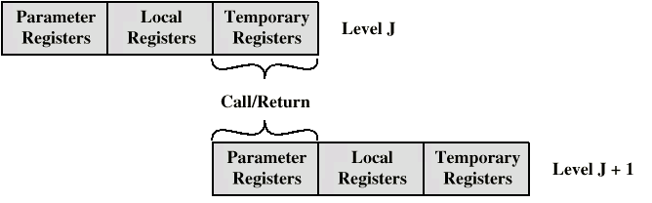
Overlapping Register Windows

Slide 15
Register Windows Contents.
  Three areas within a register set
    Parameter registers
    Local registers
    Temporary registers
  Temporary registers from one set overlap parameter registers from the next
    This allows parameter passing without moving data

Slide 16
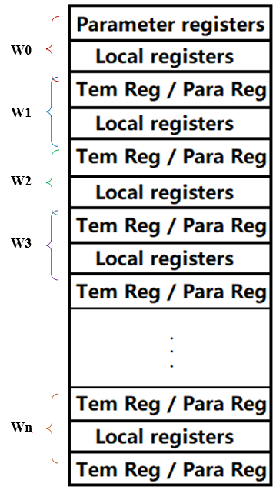
Wn+1
Stack

Slide 17
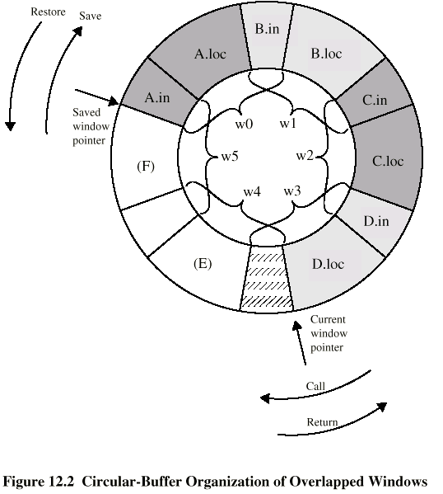
Circular-Buffer Organization of Overlapped Windows

Slide 18
Operation of Circular Sets of Register
  When a call is made, a current window pointer is moved to show the currently active register window
  If all windows are in use, an interrupt is generated and the oldest window (the one furthest back in the call nesting) is saved to memory
  A saved window pointer indicates where the next saved windows should restore to
  N-windows can hold only N-1 procedure calls. Typically, 8 windows of 16 registers each is adopted
    Berkeley RISC

Slide 19
Global Variables
  If we declare some variables as global in a HLL,
  a typical method is
    Allocated by the compiler to memory
      Inefficient for frequently accessed variables
  The other is to have a set of registers for global variables
    Do it by compiler

Slide 20
Large Registers v Cache
  The registers, organized into windows, act as a small, fast buffer for holding a subset of all variables
  From this view point, the register set is much like a cache
  Who is better?

Slide 21
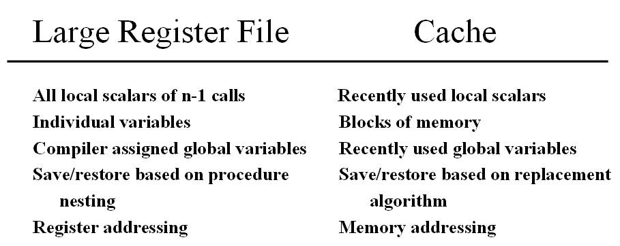
Feature Compare of Register Set And Cache

Slide 22
Specifications for Register Set And Cache
  Windows-based registers are faster, but cache may make more efficient use of space, because it is reacting to the situation dynamically
  Cache may suffer from another sort of inefficiency: data are read into in block, some of which will not be used
  In register file,using memory is relatively in- frequently, set associative cache will suffer from overwriting used variables
  Register file is shorter addressing mode, faster than cache
  In general, register file is superior for variables

Slide 23
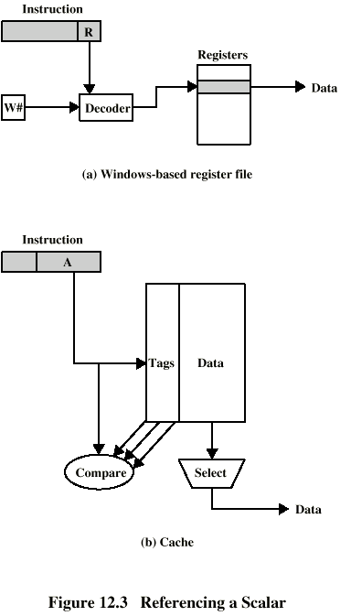
Referencing a Scalar - Window Based Register File

Slide 24
Referencing a Scalar - Cache

Slide 25
13.3 Compiler Based Register Optimization
Large register set can improve performance of a computer, how about a small number of registers?
Assume small number of registers (16-32) in RISC, we can obtain a high performance also by using optimized registers
Optimization is done by the RISC compiler

Slide 26
How to Optimize?
  HLL programs have no explicit references to registers
    usually - think about C - register int
  Assign symbolic or virtual register to each candidate variable
  Map (unlimited) symbolic registers to real registers
  Symbolic registers that do not overlap can share real registers
  If you run out of real registers some variables use memory, and so, load-and-store DRAM operations are minimized

Slide 27
Registers Optimization based on Graph Coloring
  The essence of the optimization is to decide which variables can use registers at any given point in a program
  The technique most commonly used in RISC compiler is graph coloring
  Definition: given a graph consisting of nodes and edges, assign colors to nodes such that adjacent nodes have different colors, and the number of colors are minimized.

Slide 28
  The nodes are symbolic registers, if two symbolic registers are “live” during the same program fragment, they are joined by an edge to depict interference
  Try to color the graph with n colors, where n is the number of real registers
    Colors represents the number of physical registers
    The same color means the same register
  If this process does not fully succeed, then those nodes that cannot be colored must be placed in memory

Slide 29
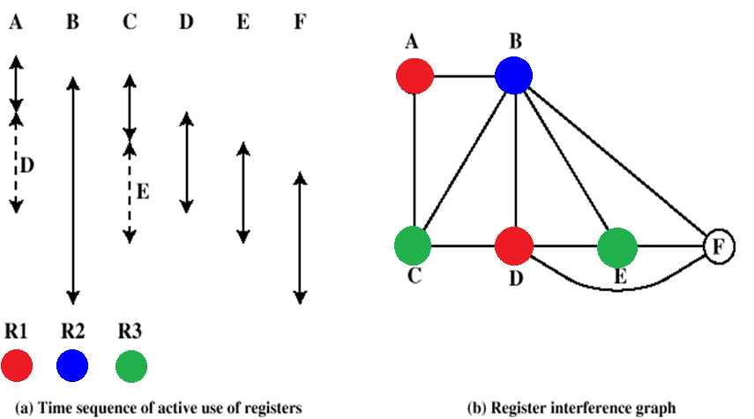
Graph Coloring Approach

Slide 30
13.4 Reduced instruction set architecture
Why CISC?
  Compiler simplification?
    Disputed…
    Complex machine instructions harder to exploit
    Optimization more difficult
  Smaller programs?
    Program takes up less memory but…
    Memory is now cheap
    May not occupy less bits, just look shorter in symbolic form
      More instructions require longer op-codes
      Register references require fewer bits

Slide 31
  Faster programs?
    Bias towards use of simpler instructions
    More complex control unit
    Microprogram control store larger
    thus simple instructions take longer to execute
  It is far from clear that CISC is the appropriate solution

Slide 32
RISC Characteristics
  One instruction per cycle
  Register to register operations
  Few, simple addressing modes
  Few, simple ,fixed instruction formats
  Hardwired design (no microcode)
  Effectively instruction pipelining
  More responsive to interrupt
  More compile time/effort

Slide 33
RISC v CISC
  Not clear cut, fighting is still going on
  Many designs borrow from both philosophies
  e.g. PowerPC and Pentium II

Slide 34
13.5 RISC Pipelining
Most instructions are register to register
Two phases of execution
  I: Instruction fetch
  E: Execute
For load and store, three phases are required:
  I: Instruction fetch
  E: Execute
    Calculate memory address
  D: Memory
    Register to memory or memory to register operation

Slide 35
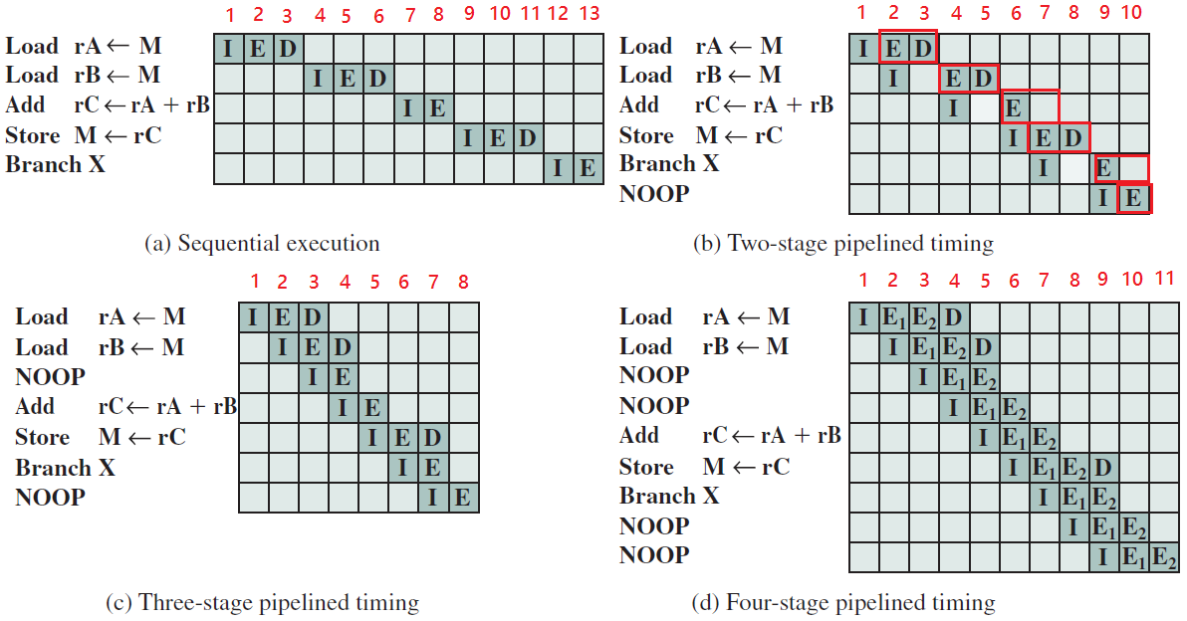
The Effects of Pipelining

Slide 36
Optimization of Pipelining
  Delayed branch
    Does not take effect until after execution of branch instruction
    This following instruction is the delay slot
  Delayed Load
    Register to be target is locked by processor
    Continue execution of instruction stream until register required
    Idle until load is complete
    Re-arranging instructions can allow useful work while loading

Slide 37
Normal, Delayed and Optimized Branch
Address Normal Delayed Optimized
100 LOAD X,A LOAD X,A LOAD X,A
101 ADD 1,A ADD 1,A JUMP 105
102 JUMP 105 JUMP 106 ADD 1,A
103 ADD A,B NOOP ADD A,B
104 SUB C,B ADD A,B SUB C,B
105 STORE A,Z SUB C,B STORE A,Z
106 STORE A,Z

Slide 38
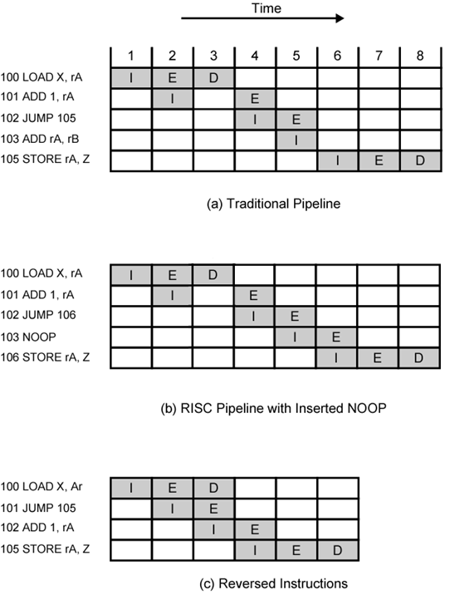
Use of Delayed Branch

Slide 39
Optimization of Pipelining
  Loop Unrolling
    Replicate body of loop a number of times
    Iterate loop fewer times
    Reduces loop overhead
    Increases instruction parallelism
    Improved register, data cache, or TLB locality

Slide 40
do i=2, n-1
a[i] = a[i] + a[i-1] * a[i+1]
end do
do i=2, n-2, 2
a[i] = a[i] + a[i-1] * a[i+1]
a[i+1] = a[i+1] + a[i] * a[i+2]
end do
if (mod(n-2,2) = 1) then
a[n-1] = a[n-1] + a[n-2] * a[n]
end if

Slide 41
13.8 Risc Versus Cisc Controversy
Quantitative
  compare program sizes and execution speeds
Qualitative
  examine issues of high level language support and use of VLSI real estate
Problems
  No pair of RISC and CISC that are directly comparable
  No definitive set of test programs
  Difficult to separate hardware effects from complier effects
  Most comparisons done on “toy” rather than production machines
They are amalgamated gradually
  Most commercial devices are a mixture

Slide 42
Key points
Characteristics of RISC computer
Large registers &Organization of registers
Optimized pipelining

